Slide 1
STUDENT DROPOUT ANALYSIS FOR SCHOOL EDUCATION
CSE7101- Capstone Project
Review-1
Batch Number: CBD_7
Under the Supervision of,
Dr. Abdul Majid Sir,
Professor
School of Computer Science and Engineering
Presidency University
Roll Number | Student Name
20221CBD0029 | TANUSHREE R
20221CBD0021 | KAVYA S
20221CBD0023 | KAVYA J
Name of the Program: B.Tech
Name of the HoD: Dr. Pravinthraja S
Name of the Program Project Coordinator: Dr. H M Manjula
Name of the School Project Coordinators: Dr. Sampath A K , Dr. Geetha A

Slide 2
Problem Statement Number:
Organization: Government of Karnataka
Category (Hardware / Software / Both) : Software
Problem Description: Right to education is key concern for government and at school level; drop out ratio is high due to poverty and social, economic reasons. If government have drop out student analysis on following different categories, it will be very useful in framing different policies. 1. School wise 2. Area wise 3. Gender wise 4. Caste wise 5. Age/standard wise. Expected Output: Focused interventions on the high dropout rates

Slide 3
Content
Problem Statement
Objectives
Background and Related work for title Selection
Analysis of Problem Statement
Innovation or Novel Contributions
Git-hub Link
Timeline of the Project
References

Slide 4
Problem Statement
Student Dropout Analysis for School Education Right to Education is a key concern for the government. However, dropout rates remain high in schools due to multiple factors like poverty, social challenges, and economic constraints.
Problem: Lack of a structured, data-driven analysis tool for:
School-wise dropout monitoring
Area-wise dropout trends
Gender-wise dropout trends
Caste-wise dropout trends
Age/Standard-wise dropout trends Without these insights, targeted interventions are difficult to plan and implement

Slide 5
Objectives
Our project aims to:
Collect and pre-process dropout data from authentic sources.
Analyse dropout patterns using machine learning models.
Provide real-time analysis through a web-based dashboard.
Enable manual data entry via web forms for live monitoring.
Support policymakers and school authorities in identifying high-risk categories.
Facilitate focused interventions to reduce dropout rates.

Slide 6
Background and Related Work
Website Functionality Overview:
Pre-loaded dataset fed to the ML model for training & prediction.
User-friendly web interface for visual analytics.
Data input form for schools to add real-time dropout details.
Graphical representation (charts, heat maps, reports) for easy decision-making.
Related Research:
Reviewed research papers on dropout prediction using socio-economic & demographic features.
Findings indicate high correlation between dropout rates and factors like poverty, gender, caste, and locality.
Existing systems focus more on post-event reporting; few offer predictive, interactive tools

Slide 7
Analysis of Problem Statement (contd...)
Why this problem matters:
Directly impacts literacy rates and human capital development.
Government schemes (e.g., Free Education) often fail to retain certain target groups.
Gap Identified:
Absence of a tool combining data collection, prediction, and visualization in one platform.
Our Approach:
Build an integrated system for dropout monitoring + predictive analysis.

Slide 8
Technology Stack Components:
Frontend (User Interface): HTML5, CSS3, JavaScript, Bootstrap, Chart.js
Backend (Server-side): Python, Flask.
Data Processing: Pandas, NumPy, Scikit-learn, Matplotlib / Seaborn
Supervised ML Models: Logistic Regression/SVM/Decision Tree
Database: MySQL
Hosting/Deployment: GitHub
Additional Tools: VSCode, Google Colab.

Slide 9
Github Link
The Github link provided should have public access permission.
https://github.com/kav-star/student_dropout.git

Slide 10
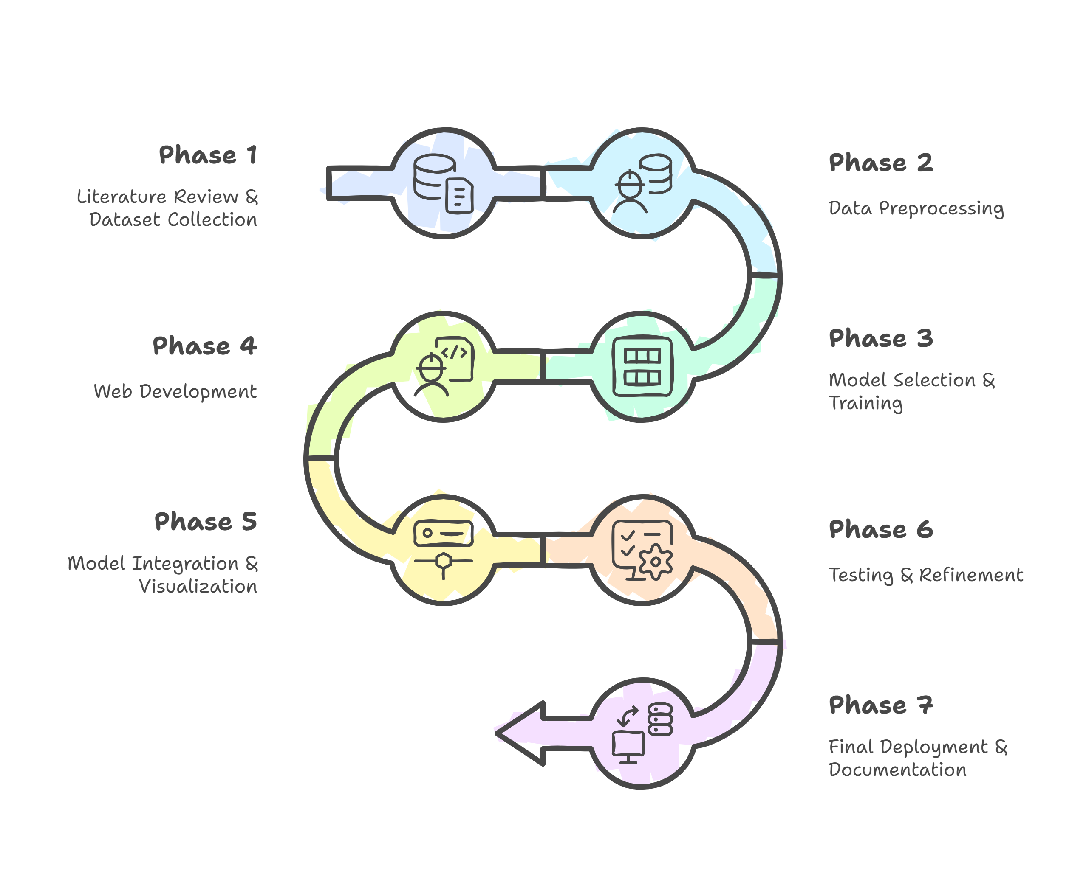
Timeline of the Project

Slide 11
References (IEEE Paper format)
[1]. Cohen, Anat. “Analysis of student activity in web-supported courses as a tool for predicting dropout,” Educational Technology Research Development 65.65 (2017): 1285-1304
[2]. Yukselturk, Erman, Serhat Ozekes, and Yalin Kilic Turel. "Predicting dropout student: An application of data mining methods in an online education program." European Journal of Open, Distance and e-learning 17.1 (2014): 118-133.
[3]. Pérez, Boris, Camilo Castellanos, and Darío Correal. "Predicting student drop-out rates using data mining techniques: A case study." IEEE Colombian Conference on Applications in Computational Intelligence. Cham: Springer International Publishing, 2018.

Slide 12


